Slide 1
Can I predict where the price of vehicle are headed?

Slide 2
The Problem
Chip prices shortage has started in February 2020, price of used car prices has also risen during this time frame. When will price of vehicle stabilize? Which type, color and brand vehicle will be a better purchase to retain the vehicle’s value
People that want to buy a car
Me, because I want to buy a minivan for family use
Lower income people as the cost of vehicle will consume larger amounts of money

Slide 3
Who it affects
People that want to buy a car
Me, because I want to buy a minivan for family use
Lower income people as the cost of vehicle will consume larger amounts of money

Slide 4
What factors affect the price
Type of Vehicle
Odometer
Age of vehicle

Slide 5
Source of data was gathered from https://www.kaggle.com/austinreese/craigslist-carstrucks-data https://www.nytimes.com/2020/05/21/business/suv-sales-best-sellers.html https://www.statista.com/statistics/276506/change-in-us-car-demand-by-vehicle-type/
The data was collected from craigslist. This data is scraped every few months, it contains most all relevant information that Craigslist provides on car sales including columns like price, condition, manufacturer, latitude/longitude, and 18 other categories.
The Trend shows that SUV are the most popular type of vehicle. My wife wants a new SUV and currently drives an SUV.

Slide 6
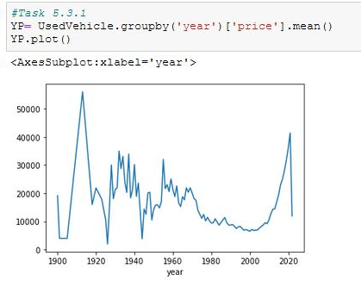
EDA
The price of all use vehicle fluctuate seems to fluctuate with age. You can see the vehicle made in around 1915-1920 seems to hold a higher mean price than average cars
There second highest peak vehicle were in the 2020

Slide 7
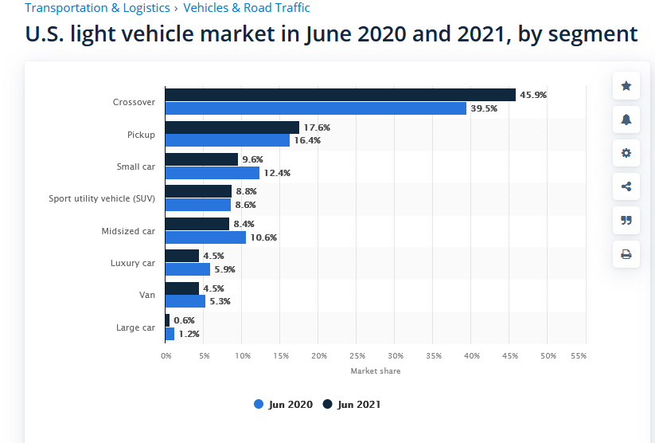
Vehicle that are popular
I group crossover with SUV because they looks of these vehicle are so similar.
SUV are usually built on truck chassis and Crossover are car chassis.
https://www.statista.com/statistics/276506/change-in-us-car-demand-by-vehicle-type/

Slide 8
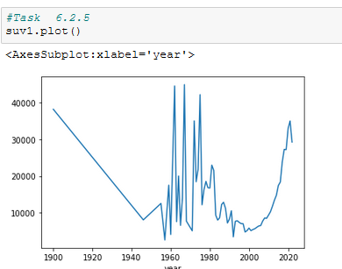
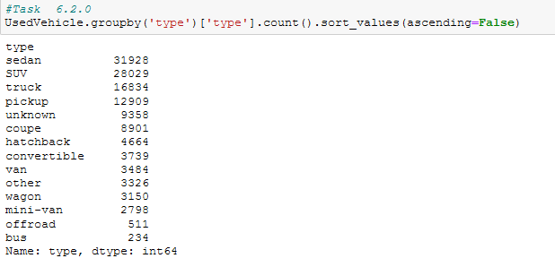
SUV Comparison
SUV Price follows trends of all Vehicle sold and hold a pretty high price
SUV are the second most popular vehicle sold

Slide 9
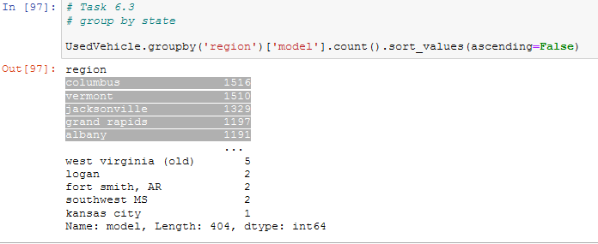
What city has most vehicle sold?
The top 5 state for vehicle sold by city is
Columbus
Vermont
Jacksonville
Grand Rapids
Albany

Slide 10
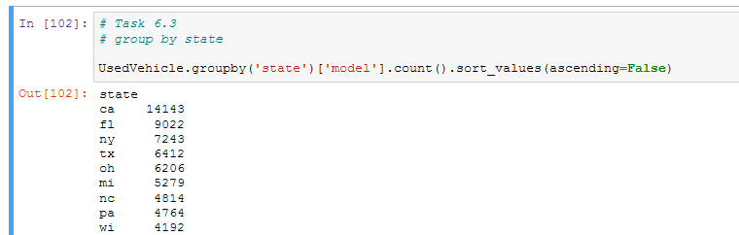
Most listed vehicle by state
Comparing the top 10 State and top 5 state, I see the matches are
Columbus, OH
Grand Rapids, MI
Albany, NY
Jacksonville, FL

Slide 11
Preprocessing
In this task we had to convert all columns from characters to numbers. One of the steps i used was convert these features into a more manageable number. I took the log10 of features 'price' and 'odometer'.
Next step was to use pd.get_dummies to convert char to numeric values.
In this notebook I split the data based on the column 'Price' into test and train data. It allows me to separate the train and test data evenly so when we model it the data is not skewed. Once the data was split, i scaled, transformed the data and saved the output to all the next step of modeling.

Slide 12
Model

Slide 13
Conclusion

